Slide 1

Computer Organization and Architecture

Slide 2


Slide 3
https://g.co/gemini/share/5df3160faa12

Slide 4
Outcome-based education
Outcome-based education or outcomes-based education (OBE) is an educational theory that bases each part of an educational system around goals (outcomes).
By the end of the educational experience, each student should have achieved the goal.

Slide 5

Washington Accord
The Washington Accord is an international accreditation agreement for undergraduate professional engineering academic degrees between the bodies responsible for accreditation in its signatory countries. The full signatories as of 2022 are Australia, Canada, China, Costa Rica, Hong Kong, India, Indonesia, Ireland, Japan, Korea, Malaysia, Mexico, New Zealand, Pakistan, Peru, Russia, Singapore, South Africa, Sri Lanka, Taiwan, Turkey, the United Kingdom and the United States.[1]
[Wikipedia]
https://notebooklm.google.com/notebook/9bfc4008-a796-4f92-b800-8ddb4ae704ab/audio

Slide 6
Differences from traditional education methods
Life skills
Basic skills
Professional and vocational skills
Intellectual skills
Interpersonal and personal skills

Slide 7
Program Outcome (graduate attributes)
Engineering knowledge
Problem analysis
Design/development of solutions
Conduct investigations of complex problems
Modern tool usage
The engineer and society
Environment and sustainability
Ethics
Individual and teamwork:
Individual and teamwork:
Communication
Project management and finance
Life-long learning

Slide 8
Bloom's taxonomy
Bloom's taxonomy is a set of three hierarchical models used for classification of educational learning objectives into levels of complexity and specificity.
It covers the learning objectives in cognitive, affective, and psychomotor domains.
The cognitive domain list has been the primary focus of most traditional education and is frequently used to structure curriculum learning objectives, assessments, and activities
The taxonomy was proposed in 1956 by Benjamin Bloom, an educational psychologist at the University of Chicago. The terminology has been recently updated to include six levels of learning

Slide 9


Slide 10
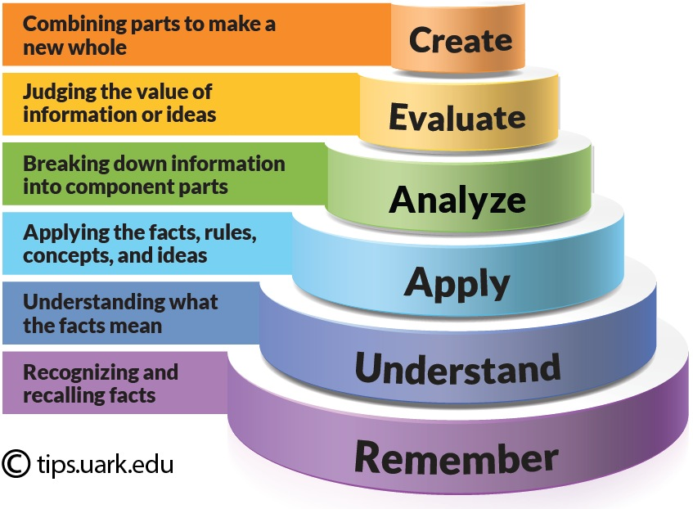

Slide 11

Course handout

